Slide 1


Introduction to
Robotic Process Automation
KYC VERIFICATION BOT
Your Register No - 220701128
Name - KEERTHIVASAN S
Guide Name - MRS.JINU SOPHIA
Designation and Department - B.E CSE

Slide 2

Abstract
The UiPath Studio KYC Verification Bot automates identity verification with OCR for accurate data extraction and validation from documents like IDs and passports. Seamless integration with external systems enhances reliability, while error handling and audit trails ensure compliance. This efficient solution streamlines KYC processes, reducing errors and expediting verification across industries.
Department of Computer Science and Engineering
Rajalakshmi Engineering College ‹#›
Notes:
2

Slide 3

Need for the Proposed System
The proposed KYC Verification Bot automates identity verification using OCR, machine learning, and biometric authentication for accurate and secure data processing. With a user-friendly interface, integration with external databases, and robust security measures, it ensures compliance, scalability, and efficiency, revolutionizing KYC procedures for modern businesses.
Department of Computer Science and Engineering
Rajalakshmi Engineering College ‹#›
Notes:
3

Slide 4
Advantages of the Proposed System
Efficiency: Automates tasks to speed up onboarding and verification.
Accuracy: Uses OCR and AI to minimize data processing errors.
Security: Employs encryption and multi-factor authentication for protection.
Compliance: Adheres to regulations with real-time updates and audit trails.
Department of Computer Science and Engineering
Rajalakshmi Engineering College ‹#›
Notes:
4

Slide 5

Literature Survey
Paper 1: "A Brief Overview to Know Your Customer" by Ali Batan
Advantage: Highlights the need for automating customer identity verification to improve efficiency.
Disadvantage: Manual KYC processes are time-consuming and prone to human error.
Department of Computer Science and Engineering
Rajalakshmi Engineering College ‹#›
Notes:
5

Slide 6

Literature Survey
Paper 2: "The New Era for KYC Process" by Laura Valo
Advantage: Emphasizes enhanced accuracy and compliance through automated solutions.
Disadvantage: Manual processes result in customer inconvenience and higher operational costs.

Slide 7

Main Objective
The primary objective of the KYC Verification Bot is to automate the identity verification process, reducing manual effort, minimizing errors, and ensuring compliance with regulatory standards. This solution aims to enhance efficiency and accuracy while providing a seamless and reliable KYC experience for businesses and their customers.
Department of Computer Science and Engineering
Rajalakshmi Engineering College ‹#›
Notes:
6

Slide 8
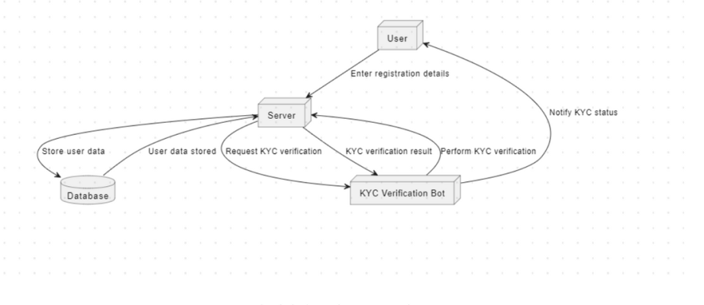
Architecture
Department of Computer Science and Engineering
Rajalakshmi Engineering College ‹#›
Notes:
7

Slide 9


System Requirements
Hardware
Processor: Intel Core i5 or higher
RAM: 8 GB minimum (16 GB recommended)
Storage: 20 GB of free disk space
Software
OCR Technology: Tesseract OCR or Google Cloud Vision API
UiPath Studio: For designing workflows
UiPath Robot: For running automated processes
Department of Computer Science and Engineering
Rajalakshmi Engineering College ‹#›
Notes:
8

Slide 10

Functional Description
Input: User uploads identity documents via the interface.
Processing: The bot extracts data using OCR, validates it, and cross-checks with external databases.
Output: Verified customer details are displayed or logged with an audit trail.
Department of Computer Science and Engineering
Rajalakshmi Engineering College ‹#›
Notes:
9

Slide 11
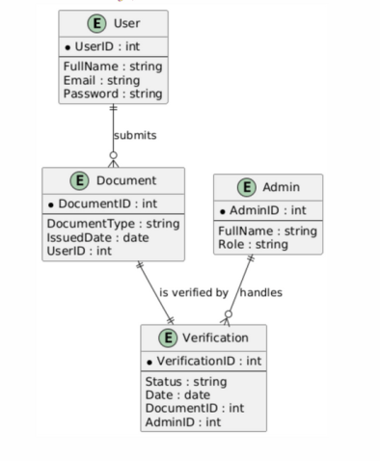
Table Design
Department of Computer Science and Engineering
Rajalakshmi Engineering College ‹#›
Notes:
10

Slide 12
Process Design
The KYC Bot extracts text data using OCR technology and validates the input.
UiPath automates data extraction and cross-verifies details with external databases.
The verified information is formatted and presented to the user, with an audit trail for compliance.
Department of Computer Science and Engineering
Rajalakshmi Engineering College ‹#›
Notes:
11

Slide 13
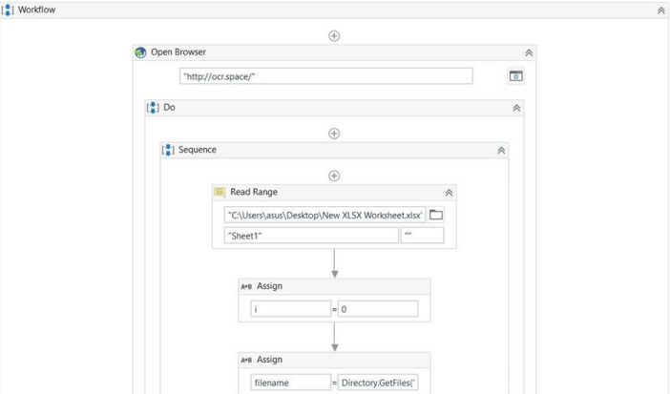
IMPLEMENTATION

Slide 14
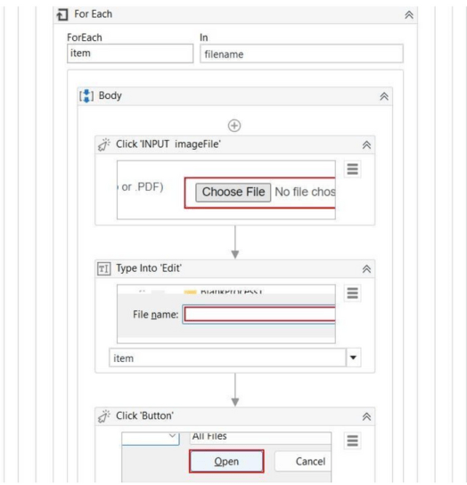

Slide 15
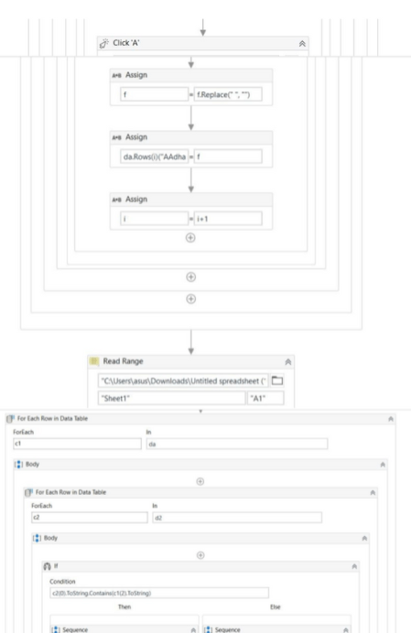

Slide 16
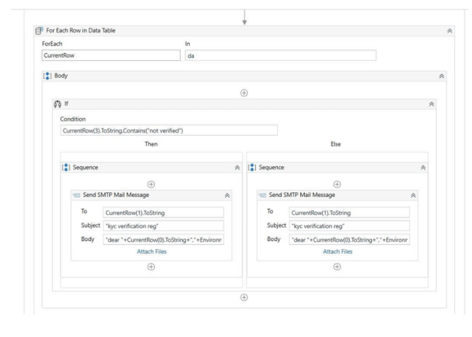

Slide 17

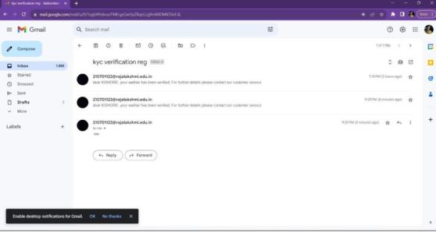
TESTING
Fig. List of number in Excelsheet
Fig. Emails received

Slide 18

Fig. Updated in Excel Sheet

Slide 19
Conclusions
The KYC Verification Bot developed with UiPath Studio offers an efficient and reliable solution to streamline the identity verification process. By automating repetitive tasks and leveraging OCR technology, the bot significantly reduces manual errors, enhances accuracy, and ensures compliance with regulatory standards. Its ability to seamlessly integrate with external databases and provide robust error handling makes it a vital tool for businesses seeking to optimize their KYC procedures. This project not only revolutionizes identity verification but also sets a benchmark for automation in regulatory processes, delivering a secure and seamless experience for both businesses and customers.
Department of Computer Science and Engineering
Rajalakshmi Engineering College ‹#›
Notes:
14

Slide 20
Future Enhancement
AI/ML Integration for enhanced fraud detection and data validation.
Multi-Language Support for global use.
Real-Time Document Verification through live photo or video.
Facial Recognition for added security.
Department of Computer Science and Engineering
Rajalakshmi Engineering College ‹#›
Notes:
15

Slide 21
IEEE Paper
"Enabling Trust and Privacy-Preserving e-KYC System Using Blockchain"
Author: Multiple authors under IEEE Journals & Magazine.
"Automation of KYC Using Robotic Process Automation (RPA)"
Author: Refer to IEEE Xplore for detailed author information.
Department of Computer Science and Engineering
Rajalakshmi Engineering College ‹#›
Notes:
16

Slide 22
References
Bicking, I. 2014. Virtualenv. Consulted 01.08.2016
https://virtualenv.pypa.io/en/latest/
Davidson, M. 2010. MySQL Server Hardening
http://security.stackexchange.com/questions/1138/mysql-server-
hardening
"Mastering UiPath" by Alok Mani Tripathi: This book covers
advanced UiPath concepts and best practices.
"UiPath Robotic Process Automation - Second Edition" by Carl
Daniel: A comprehensive guide to UiPath RPA development.
"Robotic Process Automation - Simple Steps to Win,
Insights and Opportunities for Maxing Out
Success" by Gerard Blokdijk : Explores RPA
implementations and strategies.
Department of Computer Science and Engineering
Rajalakshmi Engineering College ‹#›
Notes:
17

Slide 23
QUERIES
1. How does the KYC Verification Bot handle invalid documents?
Answer: The bot uses OCR-based validation to detect inaccuracies and alerts the user for corrections while logging errors in the audit trail for compliance.
2. How does the KYC Verification Bot ensure user data security?
Answer: The bot encrypts data during transmission, adheres to GDPR standards, and uses role-based access control for secure information handling.
Notes:
18

Slide 24
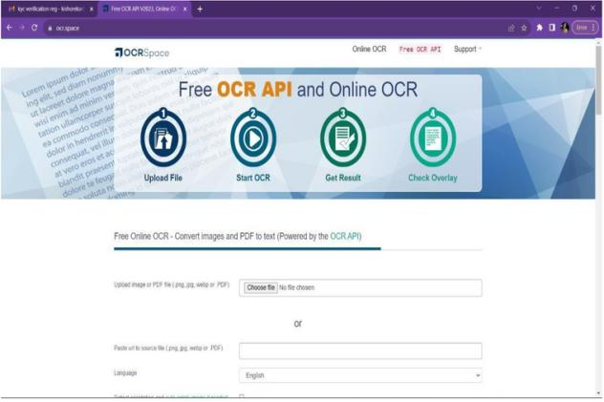
Demonstration
Fig Uploading input file

Slide 25
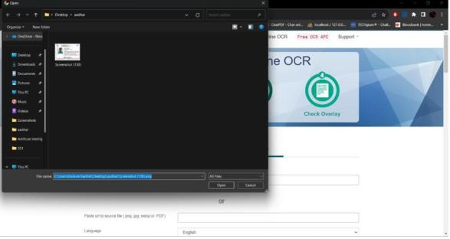
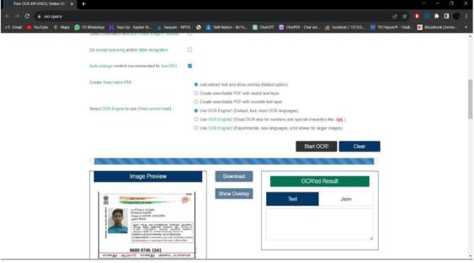
Fig. Input File Search
Fig. Input file uploaded

Slide 26
Thank You
Notes:
20

